Slide 1

Anonymous Feedback wall
Midterm Defense on
Presented by:
Shulabh Shrestha
BCSIT
2024-2-08-0747
Uniglobe College
Supervised by:
Mr. Bipin Maharjan
Date: 11th January 2026

Slide 2
Outline
Introduction
Statement of Problem
Objectives of the Project
Scope of the Project
Proposed System Overview
System Design
Proposed Methodology
Tools and Technologies
Expected Outcomes
Project Timeline
Screenshots of finished web-pages
References

Slide 3
Introduction
Web-based platform for collecting anonymous feedback
Ensured privacy and security for users submitting opinions.
Enables organizations, schools and workplaces to gather honest input
Build using PHP, HTML, CSS and JavaScript for functionality

Slide 4
Statement of Problem
People hesitate to give honest feedback due to fear of judgement or exposure.
Lack of secure, anonymous platforms
Target users: Students, employees and organizations seeking genuine feedbacks.

Slide 5
Objectives of the Project
To enable users to submit feedback anonymously(or non-anonymously) and securely.
To provide administrators with an organized system to view and manage collected feedback

Slide 6
Scope of the Project
What it includes:
Database storage for feedback entries
Creation of rooms for feedback submission and viewing
User authentication for administrators
Limitations:
Advanced analytics or reporting tools
Notification system

Slide 7
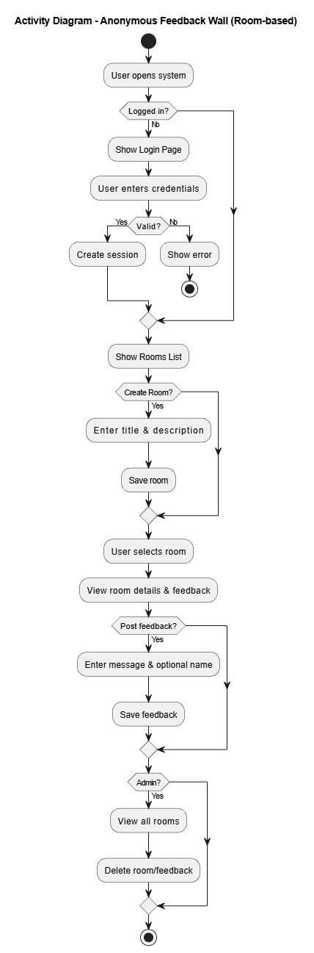

Proposed System Overview

Slide 8
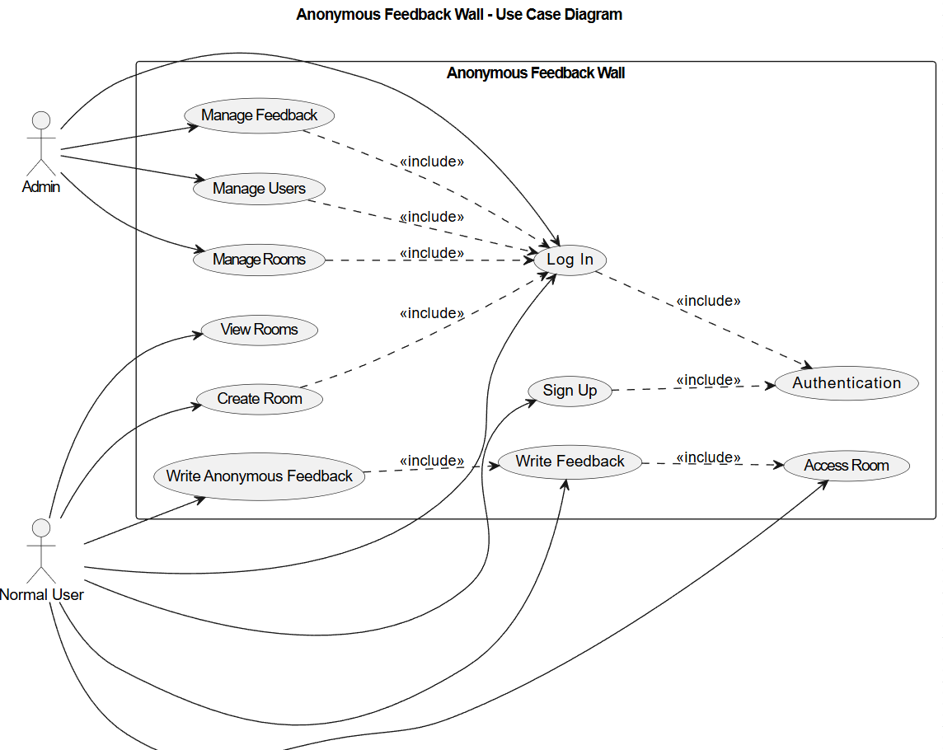
System Design
Use case diagram

Slide 9
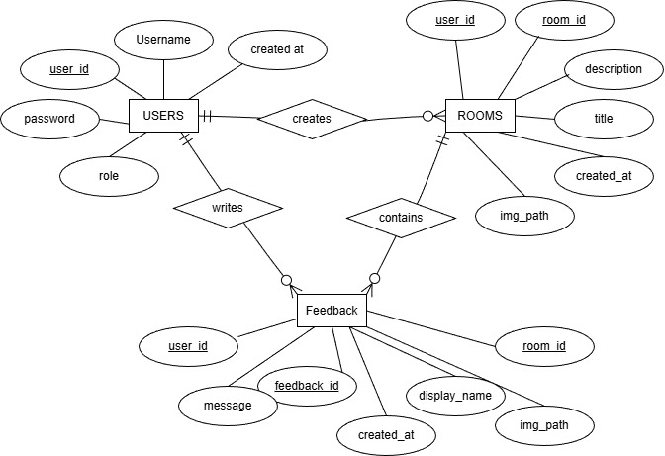
ER DIAGRAM

Slide 10
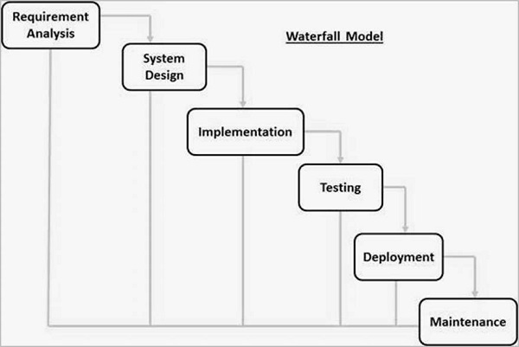
Proposed Methodology
Waterfall model
Outline of Development Stages :

Slide 11
Tools and Technologies
Programming Language: PHP
Database: MySQL
Front-end: HTML, CSS, JavaScript
Server: Apache

Slide 12
Expected Outcomes
Successful user and admin log in
Correct anonymity toggle
Successful Room Creation and View
Successful submission
Successfully viewing feedbacks that were submitted by the users sharing a common group
Successful administrative actions such as deleting feedbacks and users

Slide 13
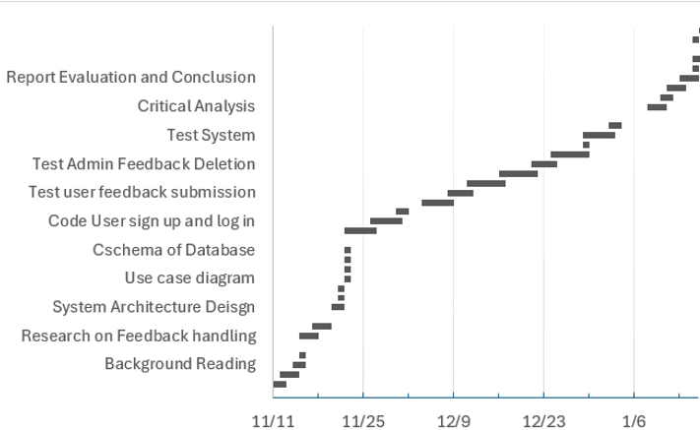
Project Timeline (Gantt Chart)
Gantt chart diagram only
complete
In progress
To-do

Slide 14
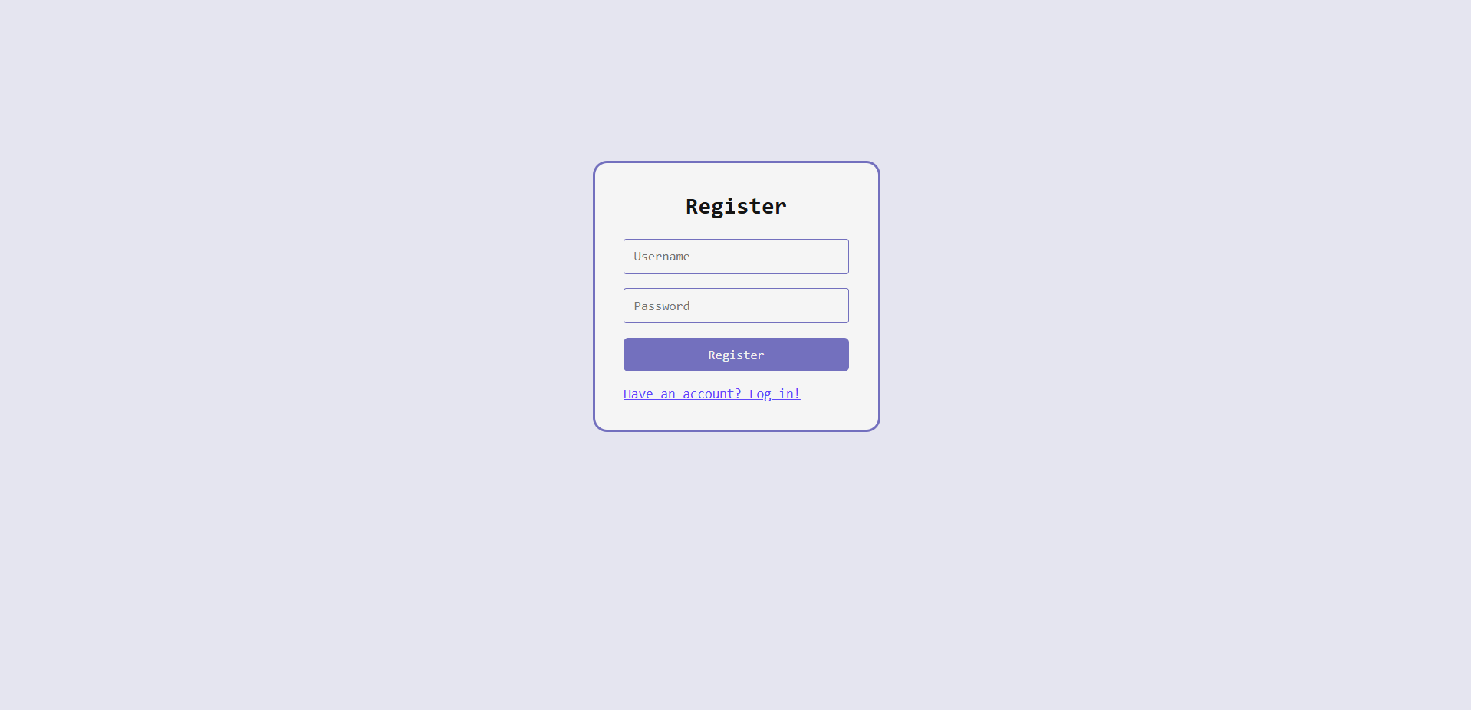
Screenshots of finished web-pages
Register page
The page where user enters their username and password to register their data to the database

Slide 15
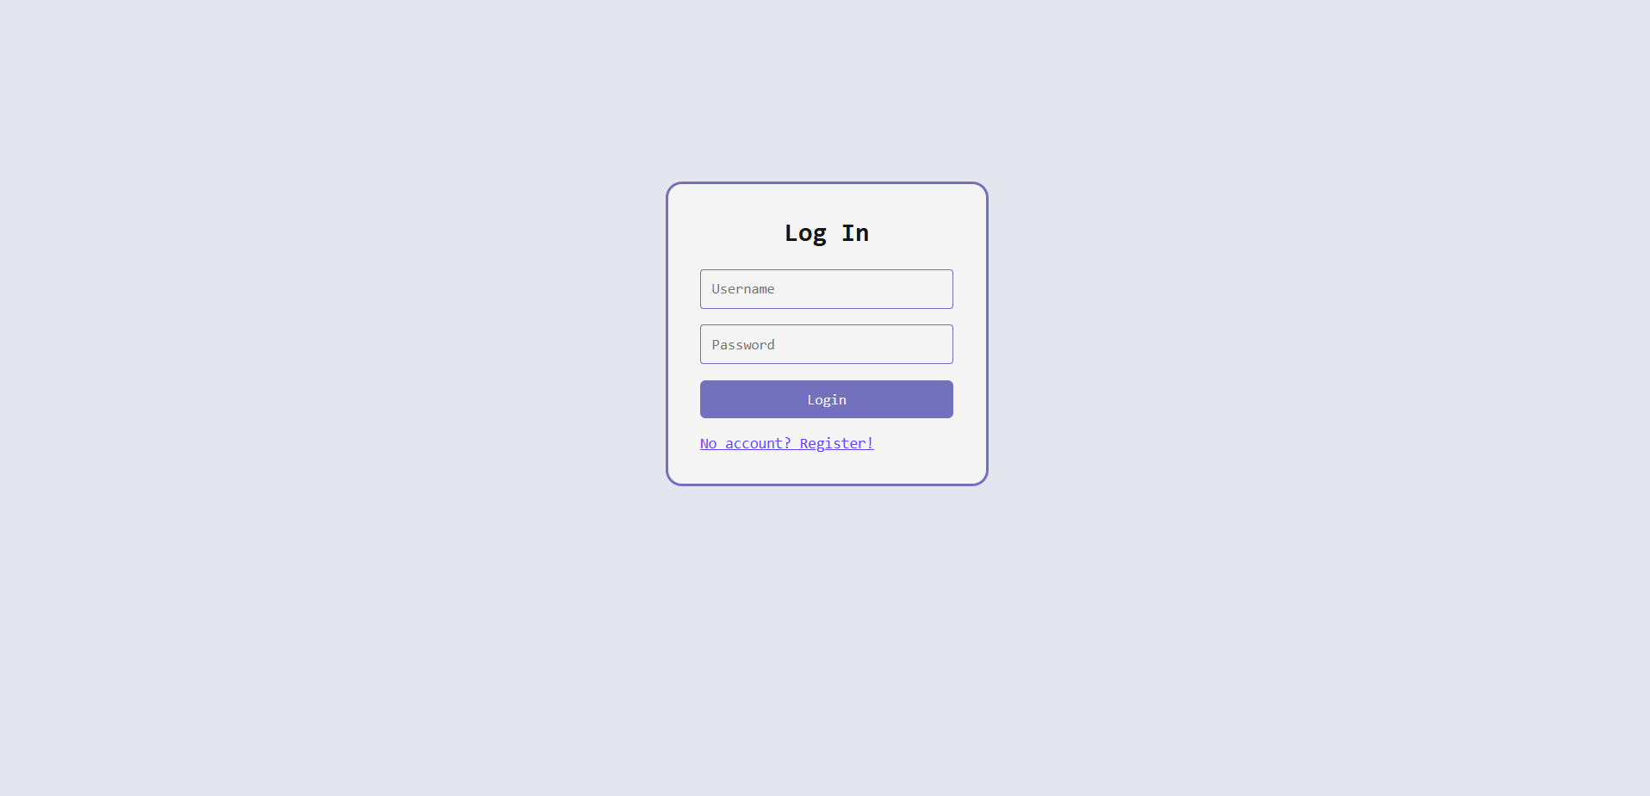
Screenshots of finished web-pages
Login page
The page where user enters valid credentials to log in and go to their respective page

Slide 16
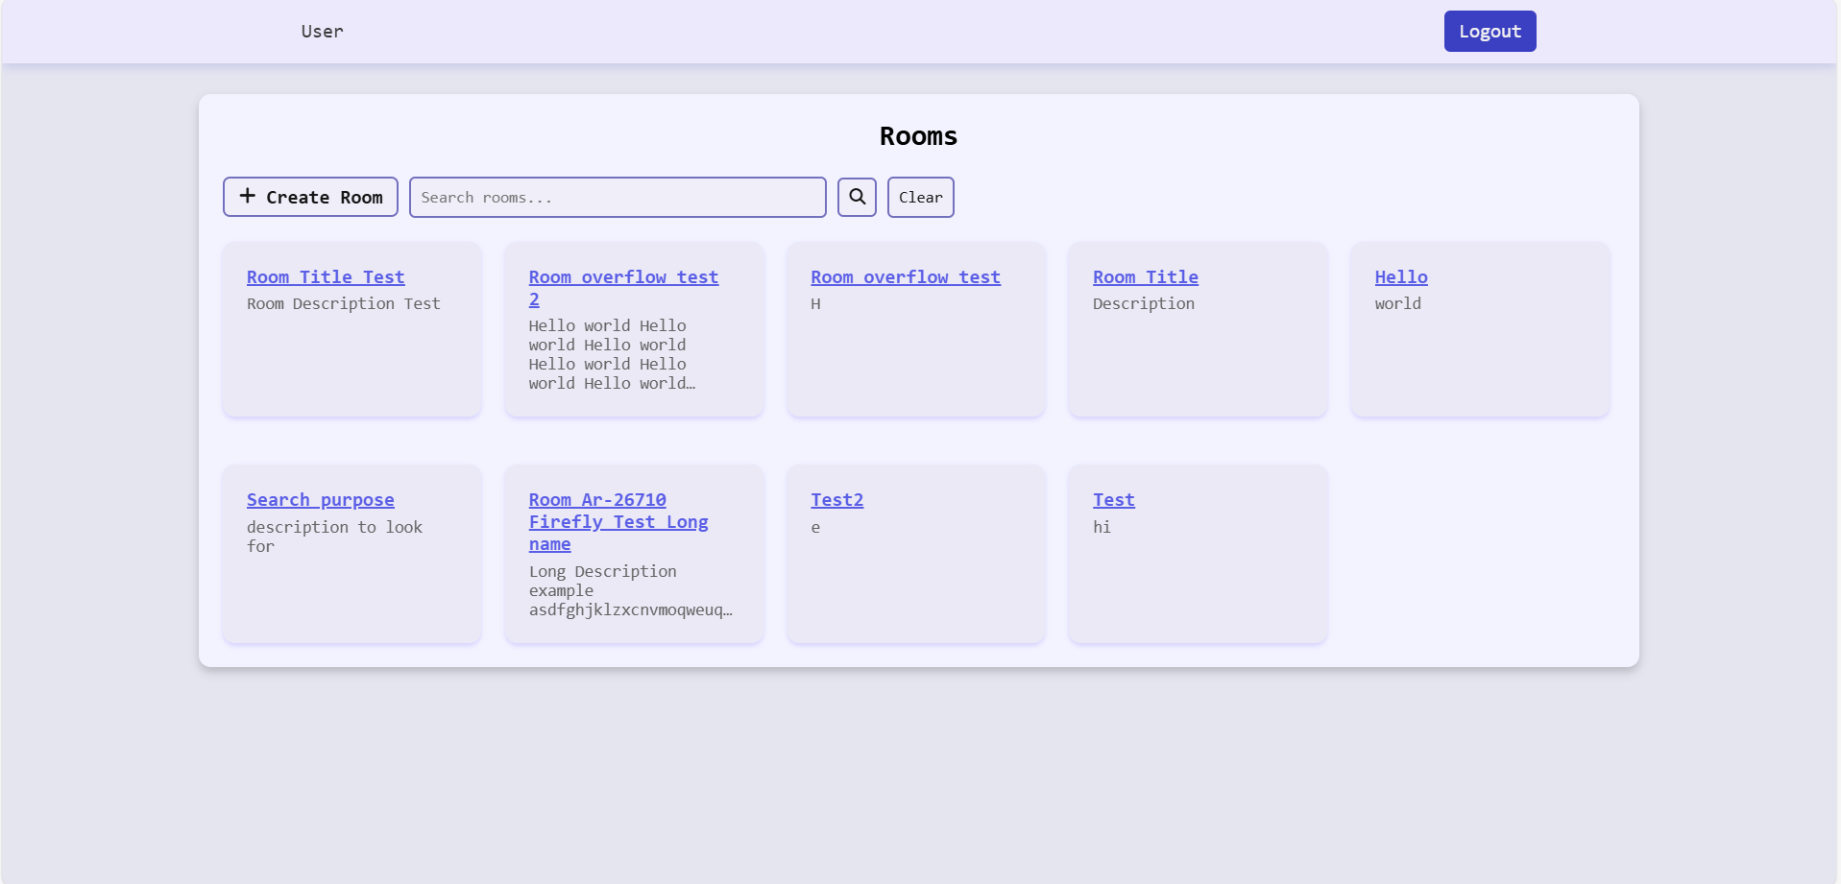
Screenshots of finished web-pages
Rooms page
The page a normal user sees after logging in, it consists of all the available rooms. User is able to search and create their own room.

Slide 17
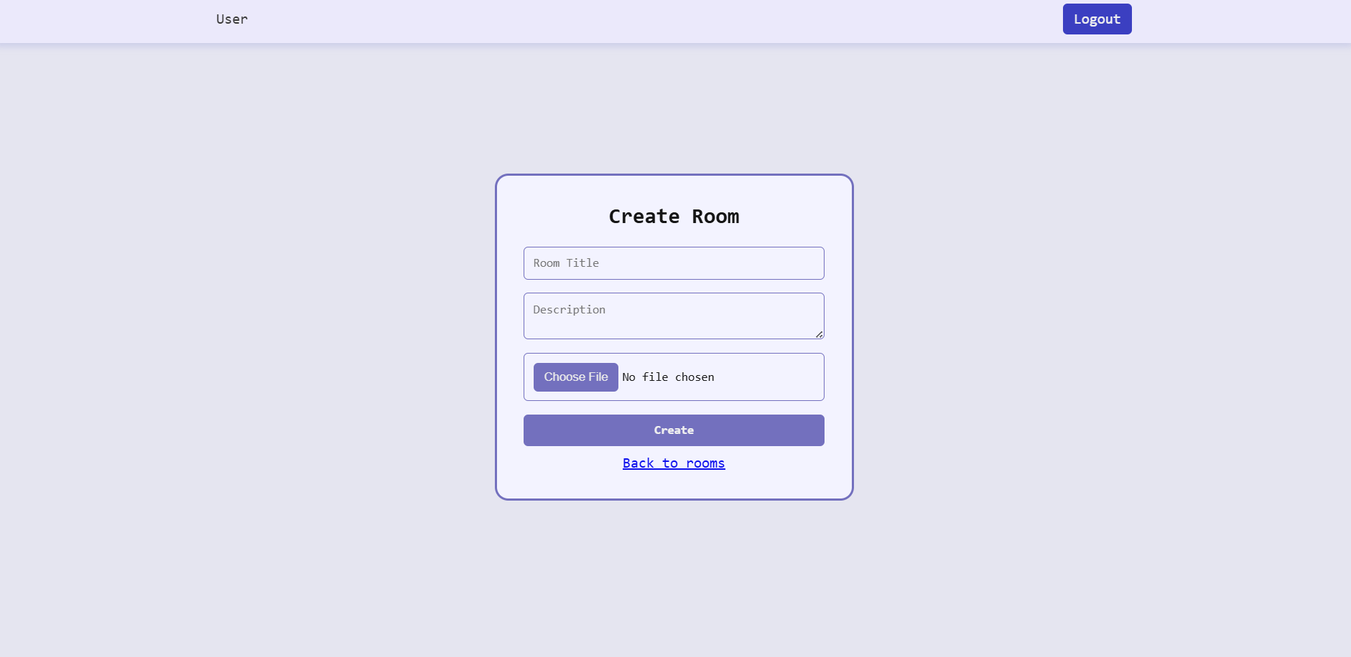
Screenshots of finished web-pages
Create Room page
The page user sees after clicking on “Create Room” on Rooms page. This is where user can enter room title, description and image(not functional at the moment) which will then be displayed in rooms page

Slide 18
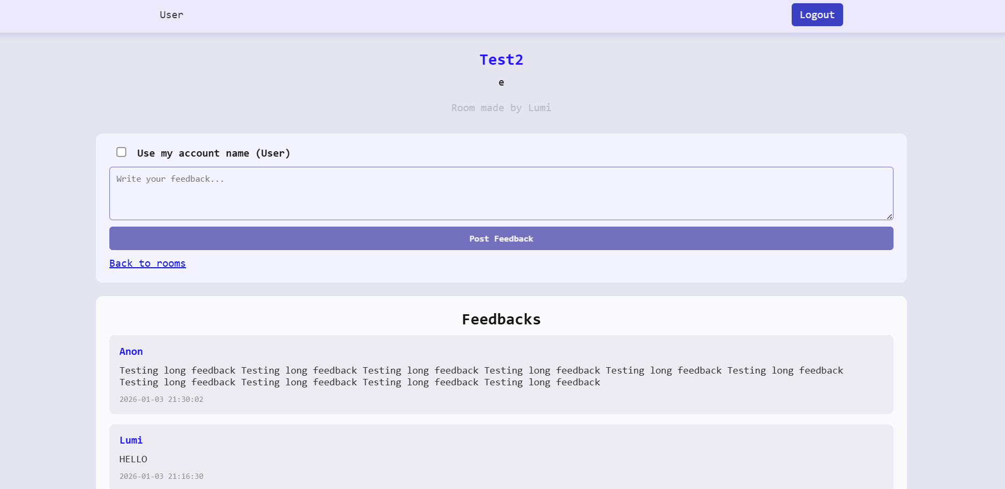
Screenshots of finished web-pages
Room page (Room name: Test2)
This is the room page after clicking on one of the rooms(For this, Test2 room) in the Rooms page. This page consists of Room title, description and the author. It also consists of viewing feedback other users posted, and the user can also post feedback anonymously or non anonymously

Slide 19
References
Shaheen, A., Azam, F., & Irshad, K. (2021, October). Anonymous Feedback: A real-time feedback to capture students’ engagement in learning process. In International Conference on Medical Education (ICME 2021) (pp. 65-68). Atlantis Press.
Frampton, A., Fox, F., Hollowood, A., Northstone, K., Margelyte, R., Smith-Clarke, S., & Redwood, S. (2017). Using real-time, anonymous staff feedback to improve staff experience and engagement. BMJ Quality Improvement Reports, 6(1).

Slide 20
THANK YOU!

